Slide 1

It is suggested that this presentation should be delivered to the troops combined with the environmental pocket guide and the environmental poster

Slide 2
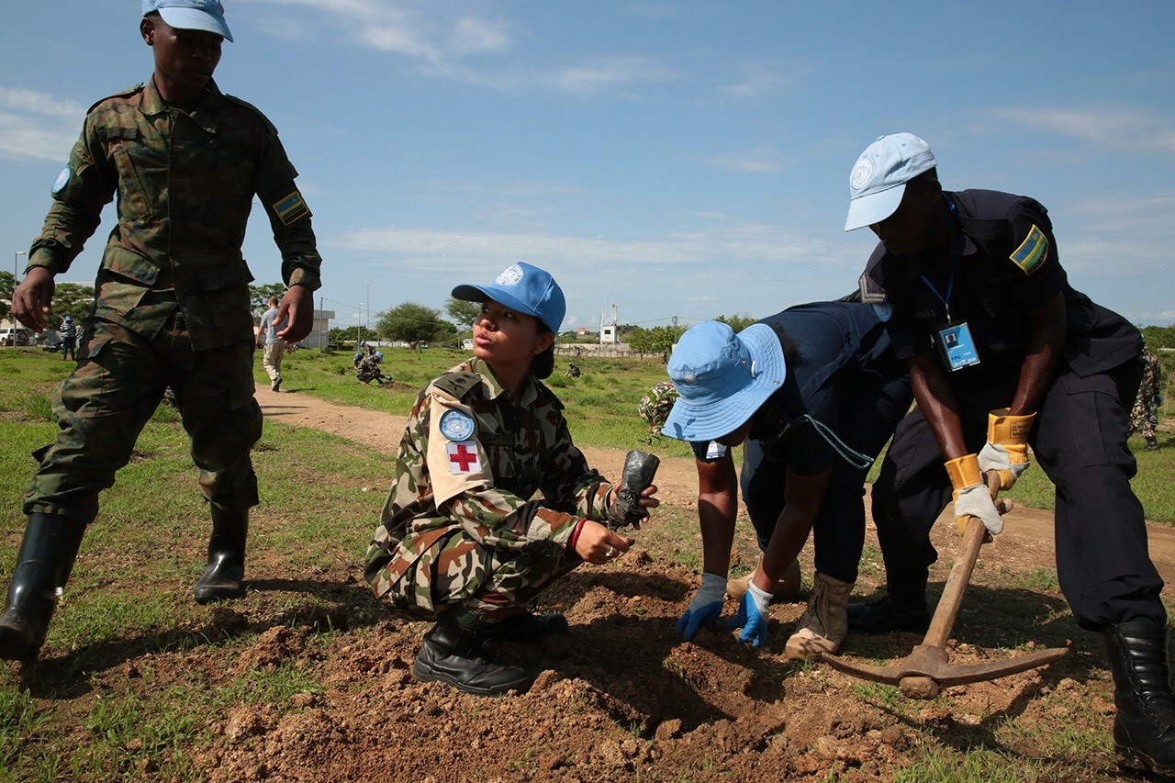

ENVIRONMENTAL AWARENESS GENERATION SESSION
Formed Military and Police Units Deployed in UN Peace Operations

Slide 3
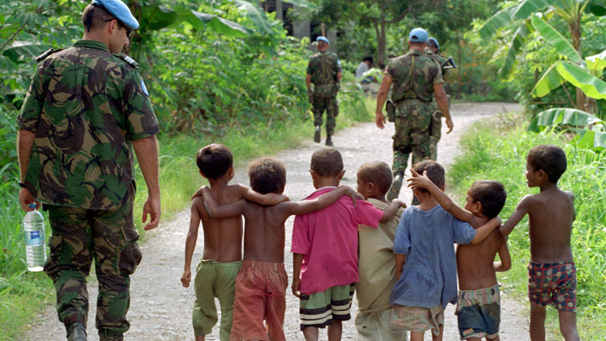
General Environmental
Management Principles
UN peacekeeping personnel are deployed in fragile environments where natural resources may be scarce and critical to the survival of the host community.
Protecting the environment can help to establish, keep or sustain peace. It is part of direct and indirect mandates and helps protect the health and safety of personnel and local people. It upholds the reputation of the UN.

Slide 4

It is important for UN credibility to walk the talk on environmental protection and climate change. Protecting the UN reputation and the military / police unit’s reputation is important to build and maintain trust amongst the host community.
Sound environmental management also generates efficiency in the use of natural resources and cost saving, while improving the safety, health and well-being of mission personnel.

Slide 5
If there is a major environmental incident in or around a UN base, e.g., fuel spill or disease outbreak, public perception may be that the UN is the main culprit.
Even small actions by one peacekeeper, e.g., littering or idling your vehicle engine, will be noticed.

Slide 6
The UN is committed to do no harm to the host community, the community livelihood, the local environment, and cultural heritage site.
As UN peacekeepers, all military and police personnel are expected to always behave as responsible stewards of the environment, upholding the UN reputation as well as the reputation of their own troop / police contributing country.

Slide 7
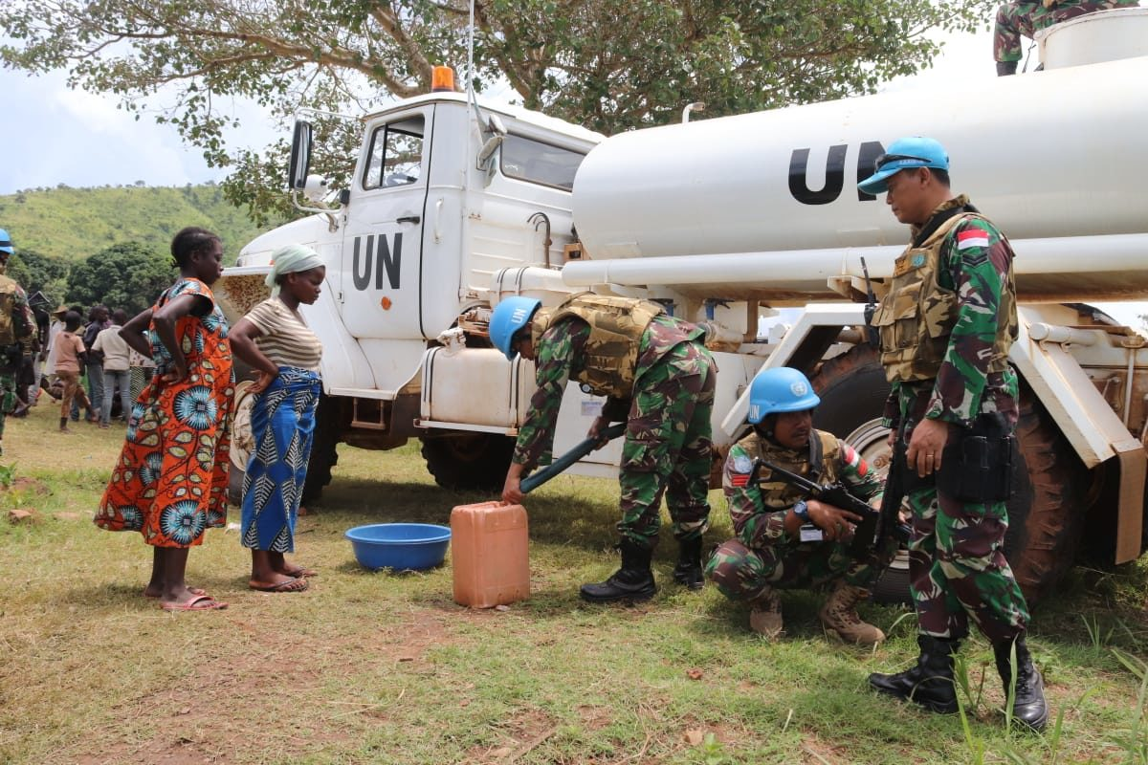
Water conservation

Slide 8
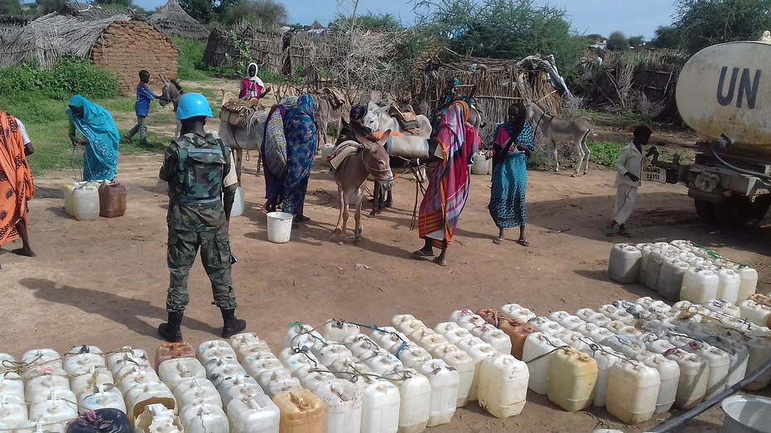
Water Conservation
Water may be scarce in the area where missions operate. Water conservation should reduce the mission’s impact on freshwater resources for the host communities.

Slide 9
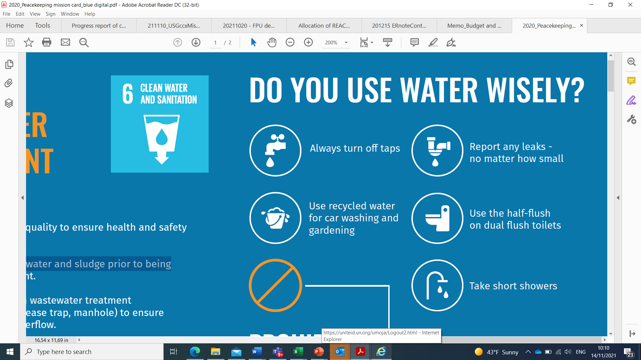
Water Conservation – Key Principles
DO | DON’T
√ Take short showers | χ Do not tolerate water leaks
√ Always turn off taps after use | χ Do not leave water hose running unattended
√ Turn off water tap when washing dishes and brushing teeth | χ Do not discharge oil or any fuel in water bodies, septic tanks, toilets or drainage channels to control mosquito breeding or odor generation
√ Wait to have a full load before doing laundry and use the washing machine short wash cycle
√ With dual-flush toilets, use the low flow flush-button as much as possible
√ Collect rainwater or reuse water running from air conditioning units to water plants
√ Report any water leak, no matter how small

Slide 10
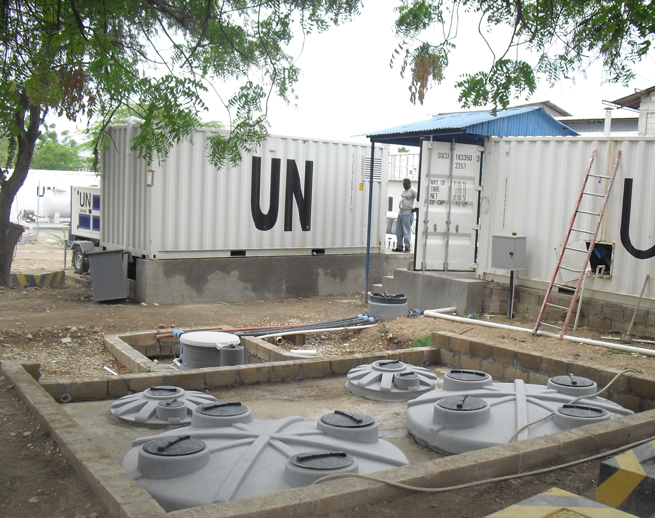
Wastewater management

Slide 11
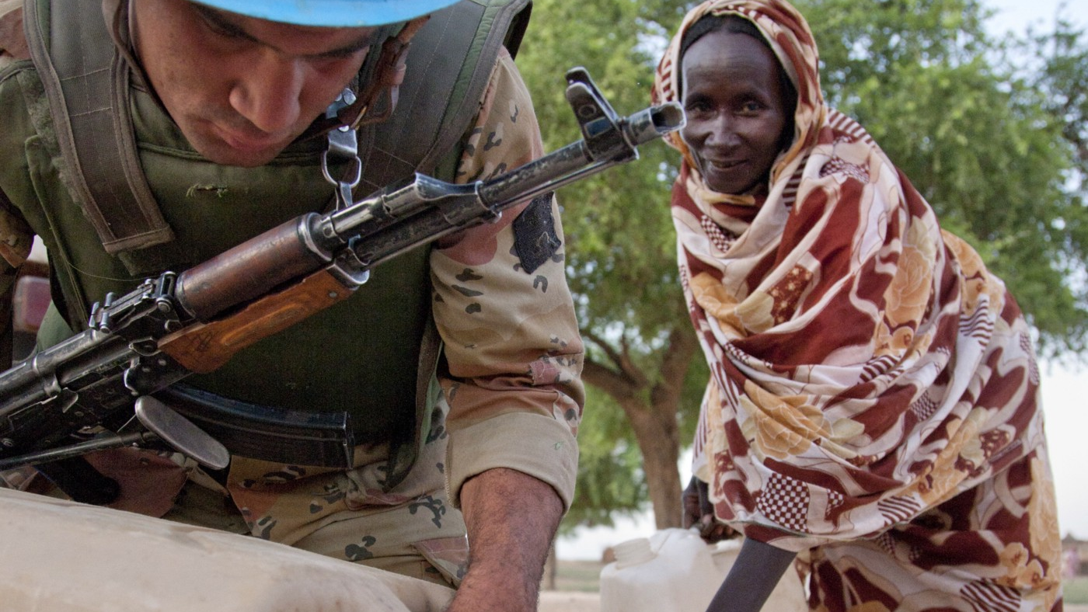
Wastewater Management
Be aware that about 80% of the water used daily eventually becomes wastewater that the mission has to manage and treat.
Individually, UN peacekeepers generate wastewater through toilet flushing, showering, personal hygiene, food preparation, laundry and car washing.
Wastewater treatment and sanitation facilities must be taken care of and well maintained to ensure proper function and avoid impact on the environment.

Slide 12
Wastewater Management – Key Principles
DO | DON’T
√ Use treated wastewater or rainwater for gardening, car washing, dust control or toilet flushing whenever possible | χ Do not flush chemical products, plastic, food waste or domestic waste down the toilet or sink as it could clog the piping network or generate breakdowns at the wastewater treatment plant downstream
√ Ensure proper hygiene and maintenance of the sanitation infrastructure (e.g., proper ablutions cleaning and maintenance, regular manholes inspection, drainage channels cleaning, etc.) | χ Do not drink or ingest treated wastewater, or use it for cooking or bathing
√ Report immediately any wastewater spill or overflows to the water and sanitation personnel of the unit | χ Do not discharge oil or any fuel in bodies of water, septic tanks or drainage channels to control mosquito breeding or odor generation

Slide 13

Energy conservation

Slide 14
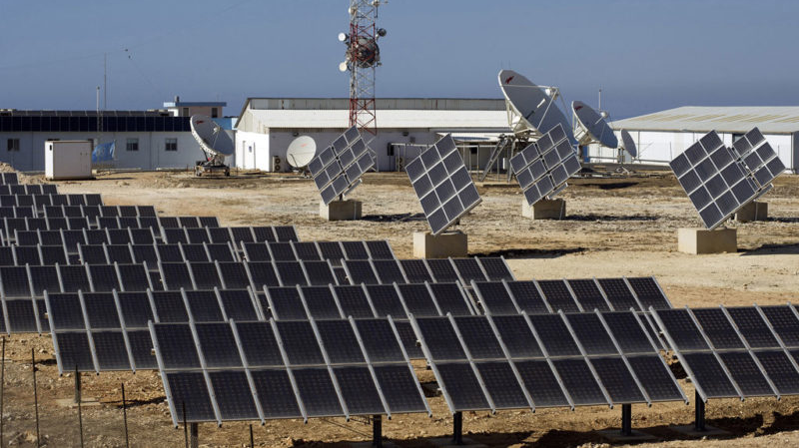
Energy Conservation
Most of the mission’s and the unit’s energy is provided by diesel generators. Greenhouse gases are emitted during the power production using generators.
To minimize the mission’s climate footprint, energy use must be minimized through energy conservation measures and substituting generators with renewable energy solutions.

Slide 15
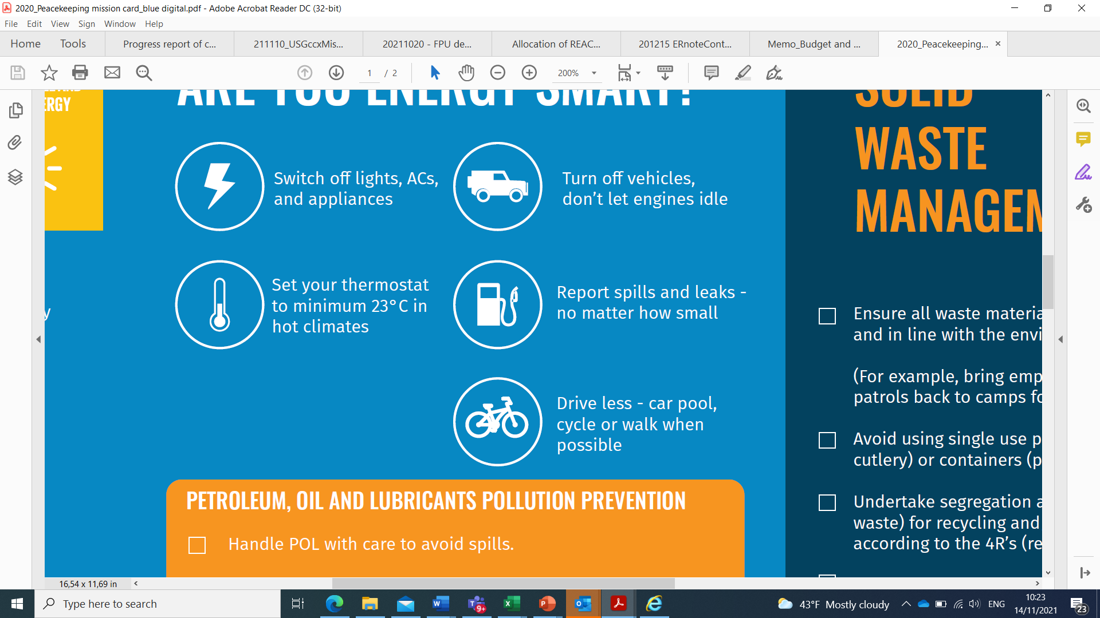
Energy Conservation – Key Principles
DO | DON’T
√ Keep windows and doors closed when using the air conditioning unit | χ Do not leave a vehicle idling, turn off the engine when the vehicle is unoccupied
√ When in your accommodation or office, set the air conditioning unit’s temperature at 23oC or higher (in warm climates) | χ Do not leave lights and air conditioning unit on when the room is unoccupied
√ Switch off the air conditioning unit and the lights when leaving the accommodation or office | χ For your own safety and that of others do not craft your own electrical connections or tamper with electrical equipment
√ After doing laundry, air dry your clothes instead of using the drying machine
√ When going on leave, switch off the air conditioning unit, and the lights, and unplug the power cords, the electronic equipment, and the electrical appliances, except for the refrigerator
√ Walk or cycle to work
√ Practice carpooling
√ Preferably use cold water when using laundry machines instead of hot water

Slide 16
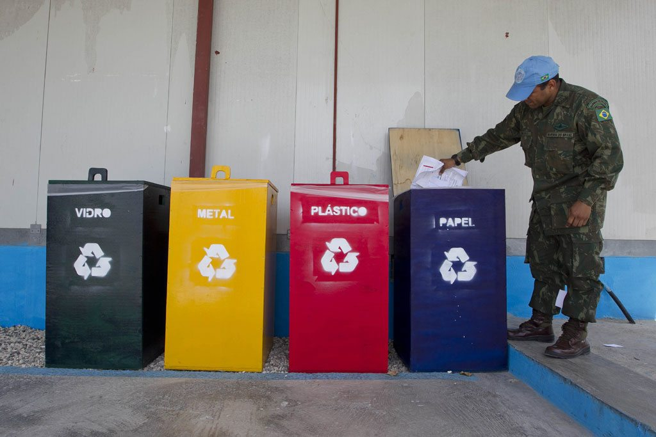
Solid Waste Management

Slide 17
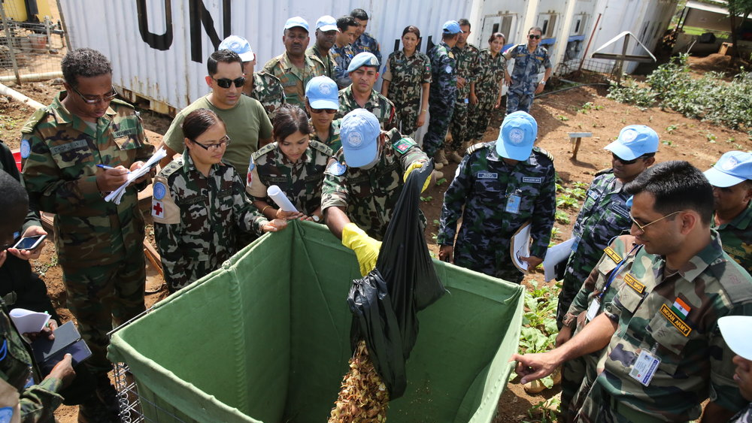
Solid Waste Management
Solid waste generated by the mission has historically been disposed of at governmental dumping sites located outside UN camps.
Solid waste can cause harm to the environment and the community if mishandled.

Slide 18
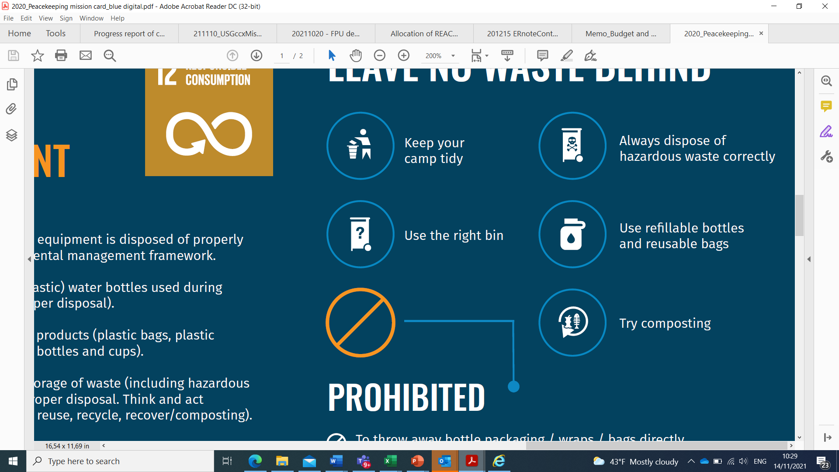
Solid Waste Management – Key Principles
DO | DON’T
√ Dispose of waste in bins only | χ Do not litter waste material
√ Segregate recyclable material (aluminum / tin cans, soft plastic bottles, glass bottles, paper / cardboard) from domestic waste | χ Do not throw away bottle packaging / wraps / juice cartons/bags directly into the local environment
√ Segregate vegetable peels, eggshells, coffee ground, tea leaves to compost them with vegetation / garden waste | χ Do not bury waste outside authorized landfills
√ In patrols, bring back all waste to the home base for proper disposal at the camp | χ Do not openly burn domestic waste
√ Use refillable water bottles | χ If possible, do not buy small plastic water bottles, less than 1 liter in volume
√ Use reusable shopping bags
√ Only prepare the amount of food you can eat, to avoid food waste
√ Consume food and rations before they expire

Slide 19
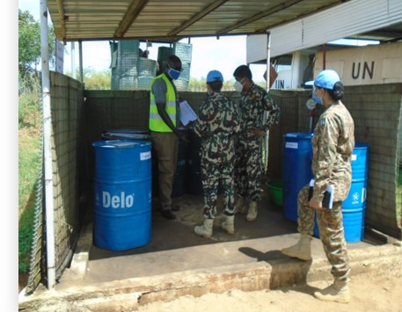
Hazardous Waste Management

Slide 20
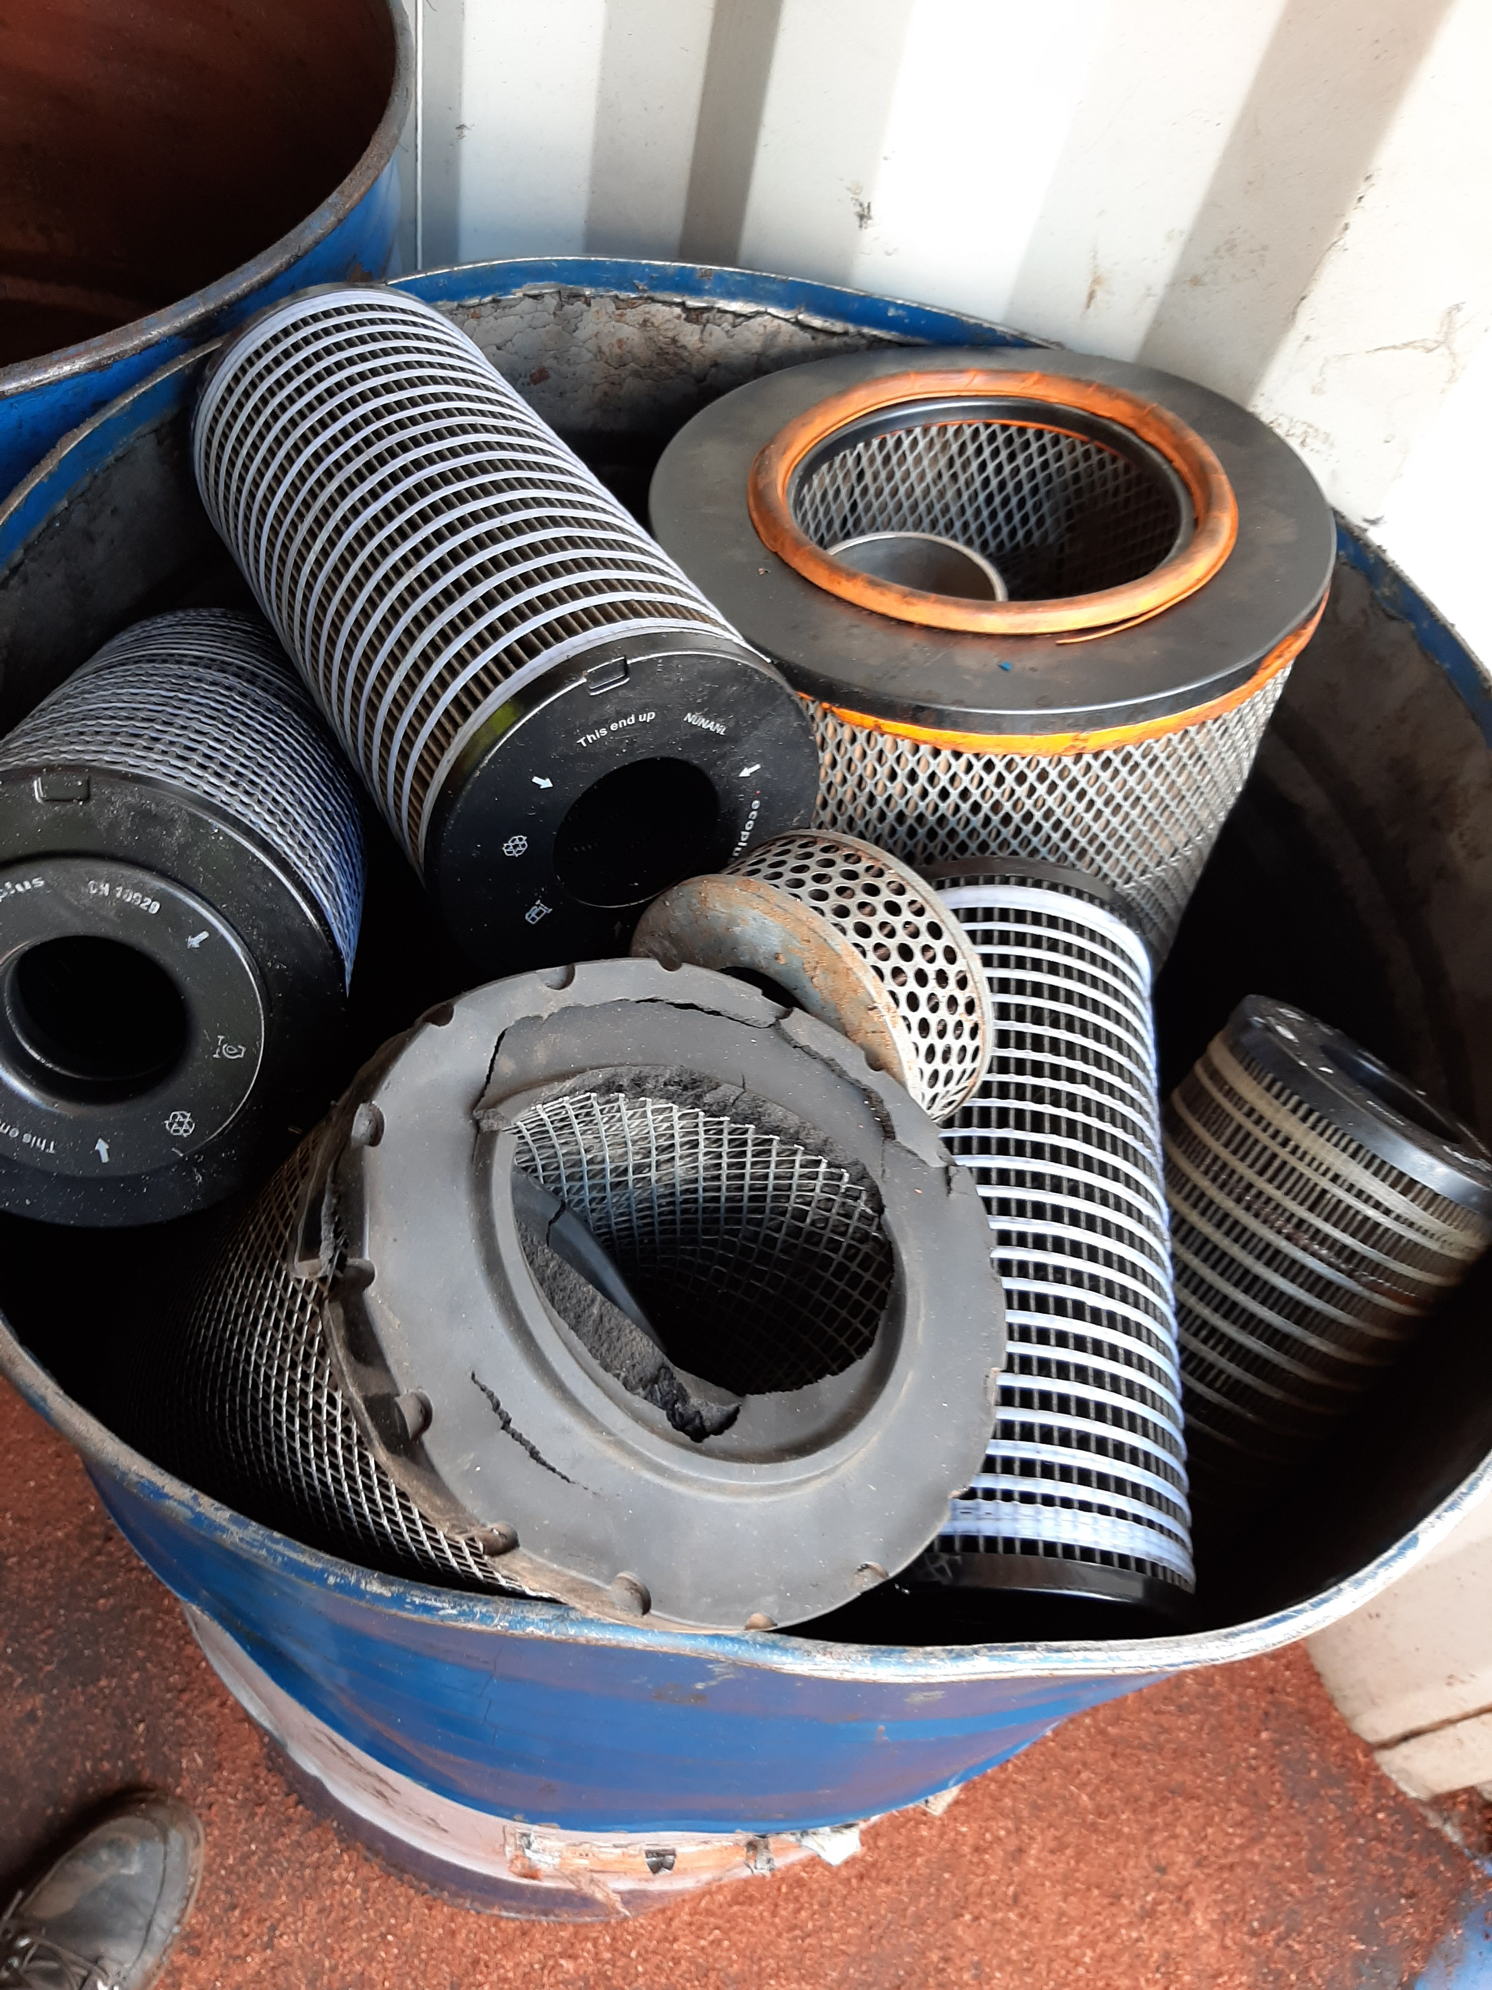
Hazardous Waste Management
Some of the material used day-to-day in UN peace operations become hazardous waste once expired, spent or used.
Hazardous waste and hazardous material must be safely managed to avoid harm to the communities, staff and the environment.

Slide 21
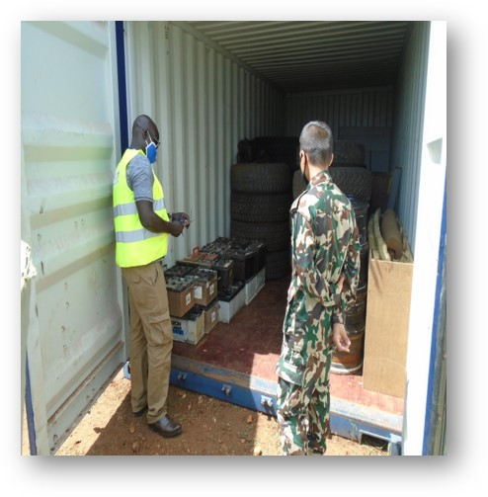
Common hazardous waste generated by UN peace operations include, but are not limited to:
  Lead-acid batteries
  Used oil, used lubricants and other POL
  Oil filters
  Biomedical waste
  Expired medicine
  Chemicals and hazardous material
  Pesticides
  Electronics
  Laboratory reagents
  Fluorescents / LED light bulbs
  Contaminated soil

Slide 22
Hazardous Waste Management – Key Principles
DO | DON’T
√ Collect and contain any oil and hazardous waste spill | χ Do not dispose of liquid hazardous waste in toilets or down the drain
√ Collect used oil generated during vehicle oil change and do not allow spillage | χ Do not bury or burn any hazardous waste
√ Bring used oil containers and oil filters to the mission designated location (ex. fuel contractor) for recycling | χ Do not dispose of expired medicine in the garbage bins
√ Bring all biomedical waste and expired medicine to the unit medical clinic for safe disposal | χ Do not dispose of hazardous waste in domestic waste bins
√ Bring all other hazardous waste to the mission designated location with a full inventory (ex. property disposal yard) for safe management | χ Do not store hazardous waste near kitchens, food storage, bodies of water, drainage channels or open flame / fire ignition sources
√ Use correct personal protective equipment (PPE) when handling hazardous materials or waste | χ Do not tolerate fuel, oil or chemical spills
√ Ensure the integrity of hazardous waste containers and store and transport hazardous waste in line with best practices
√ Immediately report fuel, oil or chemical spills and take action to contain them to prevent soil or water pollution

Slide 23

Natural Resources and Cultural Heritage

Slide 24
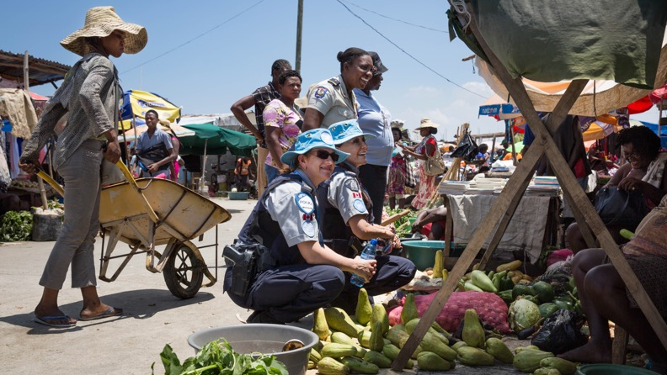
Natural Resources and Cultural Heritage
Natural resources can be essential to community livelihood, including food production, heating, well-being and other economic activities.
Natural resources such as natural ecosystems are also essential to the survival of local animals and plants, and endangered species, and to biodiversity conservation.

Slide 25
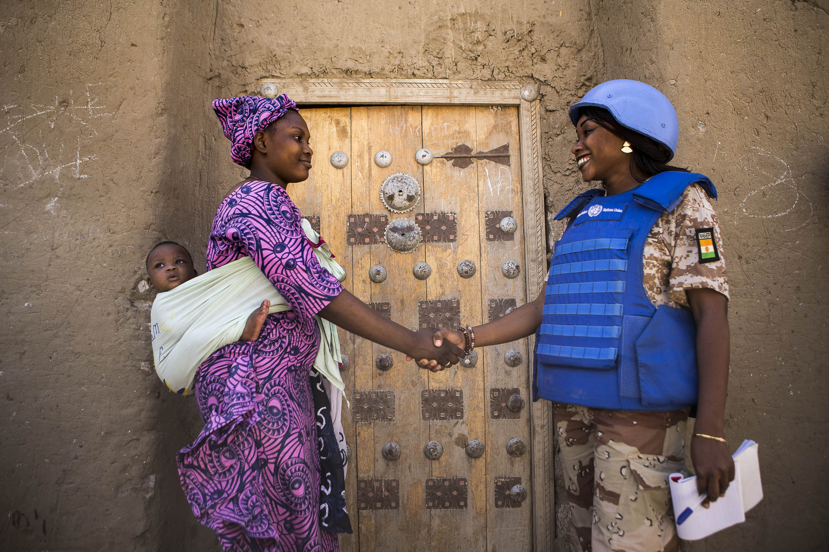
Cultural heritage sites such as sites of religious importance and archeological sites are valued by the host community and any damage to such site can impact the relationship between the UN, the community and the host government.

Slide 26

Natural Resources and Cultural Heritage – Key Principles
DO | DON’T
√ Participate in tree planting and environmental cleaning initiatives | χ Do not buy charcoal or firewood as this contributes to local deforestation
√ Minimize the risk of wildfires by properly managing waste | χ Do not use charcoal or firewood for cooking
√ Be aware of the cultural, religious and historical sites and behave in a manner respecting the local cultural practices | χ Do not encourage poaching of wildlife by buying souvenirs or bush meat
√ Practice smart printing, for example, minimizing paper use, printing on both sides of the paper, using recycled paper | χ Do not foster stray dogs and cats in camps by feeding them or improperly storing food waste
√ Get authorization from mission designated officer before cutting down mature trees | χ Do not keep indigenous animals
 | χ Do not practice hunting, logging, harvesting, collecting, purchasing or acquiring wild animals or wild plants, live or dead, or any parts and derivatives is prohibited
 | χ Do not bring plants or seeds from the home country which are not endemic to the host community
 | χ Do not plant exotic species in the host community

Slide 27
Location Based Slide
Add more specific guidance about the local environment

Slide 28



Brought to you by the Department of Operational Support and the Department of Peace Operations
28

Slide 29
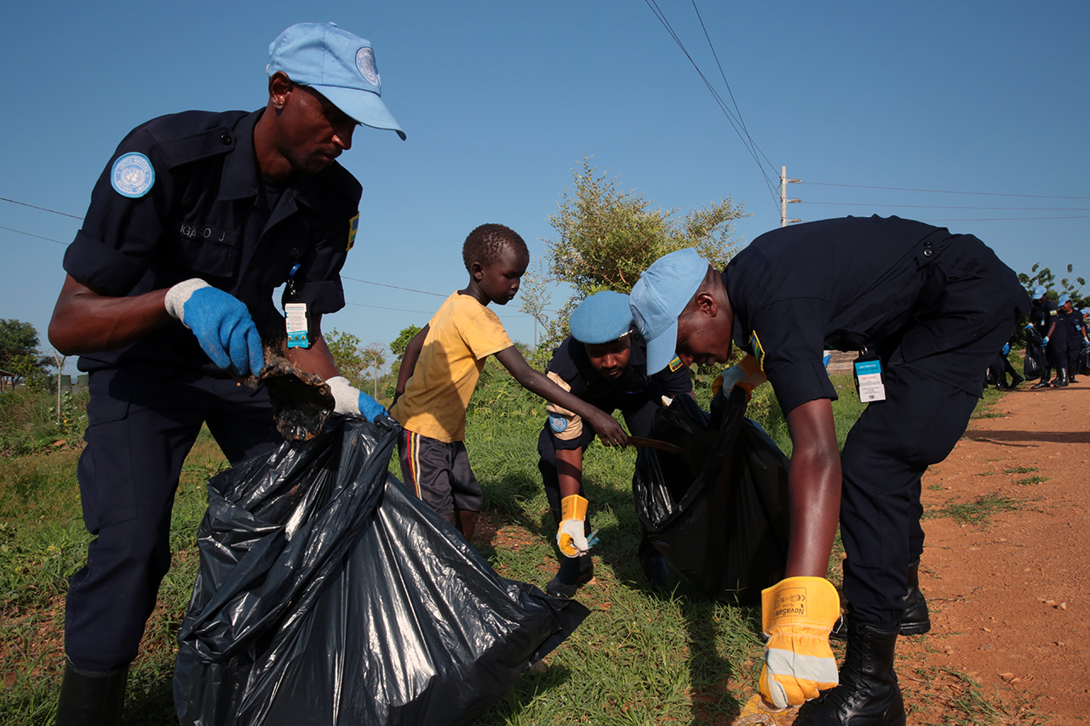
Thank you

