Slide 1

Hifujwe ko aya masomo yatangwa aherekejwe n’amabwiriza yo kurengera ibidukikije yifashishwa n’ Ingabo n’Abapolisi bari mu bikorwa byo kurinda amahoro hamwe n’ibyapa byamamaza ibikorwa byo kurengera ibidukikije

Slide 2
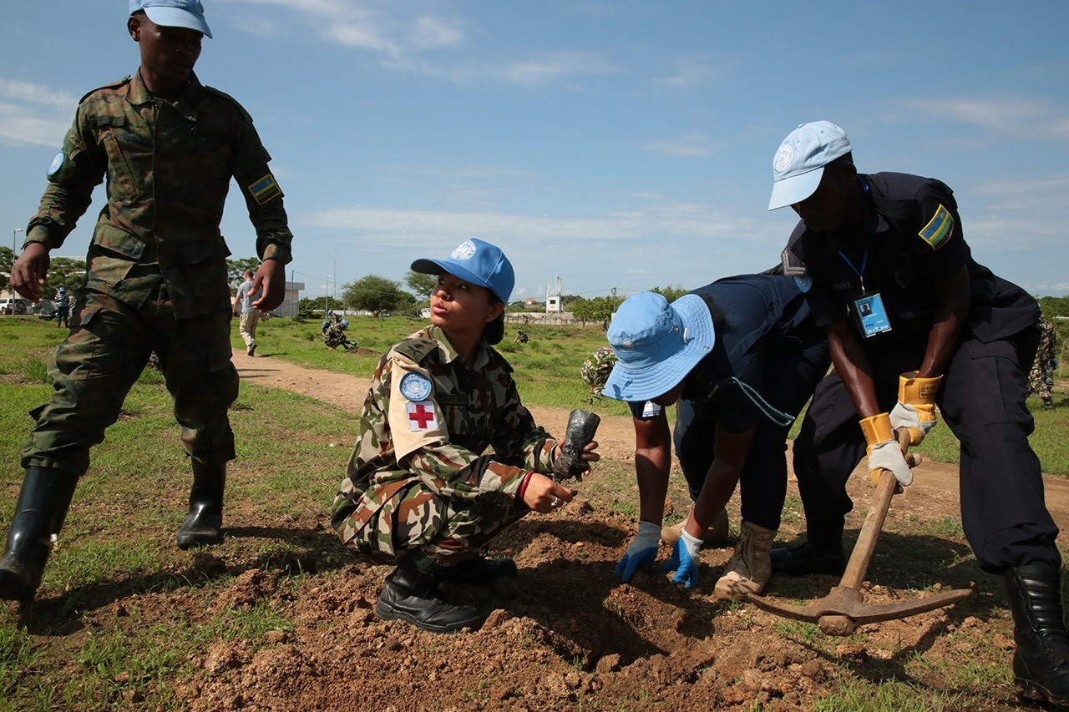

AMASOMO YO KWITA KU BIDUKIKIJE
- Agenewe Umutwe w’Ingabo n’Abapolisi ba Loni

Slide 3
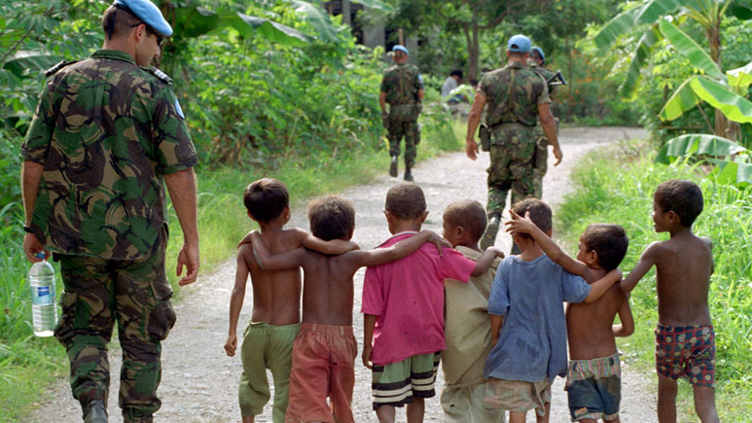
Amahame rusange yo kubungabunga ibidukikije
Abakozi b’umuryango w’abibumbye (Loni) bari mubikorwa byo kugarura amahoro bakorera ahantu hagoranye kubijyanye n’ibidukikije, aho usanga imitungo kamere idahagije mu kubeshaho abenegihugu.
Kubungabunga ibidukikije bifasha gusigasira cyangwa kugera ku mahoro arambye. Biri mu nshingano z’ubutumwa muburyo buziguye n’ubutaziguye kandi bigira uruhare mu kubungabunga umutekano n’ubuzima bw’abenegihugu. Binahesha ishema umuryango w’abibumbye(Loni).

Slide 4
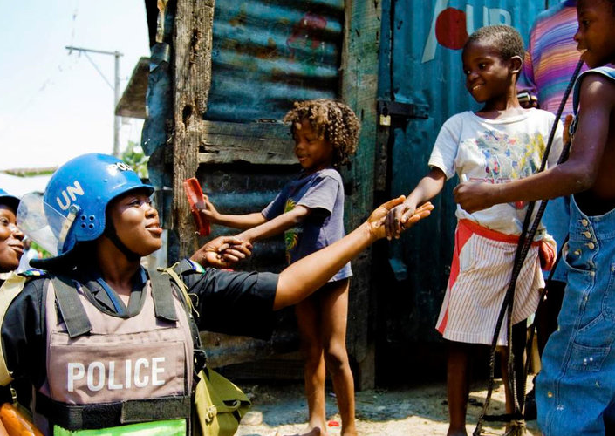
Mu rwego rwo gukomeza ikizere gihabwa umuryango w’abibumbye(Loni) ni ngombwa kubungabunga ibidukikije no gukumira ihindagurika ry’ibihe. Mu gusigasira isura nziza y’umuryango w’abibumbye(Loni) n’ ingabo na police ni ngombwa kubaka ikizere hagati y’abari mubutumwa n’abenegihugu.
Uburyo buboneye bwo kubungangabunga ibidukikije bufasha Gukoresha neza imitungo kamere no kwirinda gusesagura mu gihe binarushaho kurinda umutekano n’ubuzima bwiza bw’abari mu butumwa.
4

Slide 5
Mu gihe habayeho igikorwa kibangamiye ibidukikije mu kigo cya loni cyangwa hafi yacyo, urugero, nk’iturika ry’ibigega bya petelori, kwaduka kw’indwara z’ibyorezo, abaturage batekereza ko Loni ariyo nyirabayazana.
Niyo cyaba igikorwa gito kitabangamye cyane gikozwe n’umuntu uri mubutumwa, urugero nko kumena amavuta ya moteri bihabwa uburemere.
5

Slide 6
Umuryango w’abibumbye wiyemeje kutabangamira abenegihugu, ubuzima bwabo, ibidukikije byaho bakorera ubutumwa n’ibyanya ndangamuco.
Nk’abari mu butumwa bwo kugarura Amahoro, Ingabo na polisi bagomba kwitwara neza mubijyanye no kubungabunga ibidukikije, bityo bigahesha isura nziza umuryango w’abibumbye n’ibihugu bakomokamo.
6

Slide 7
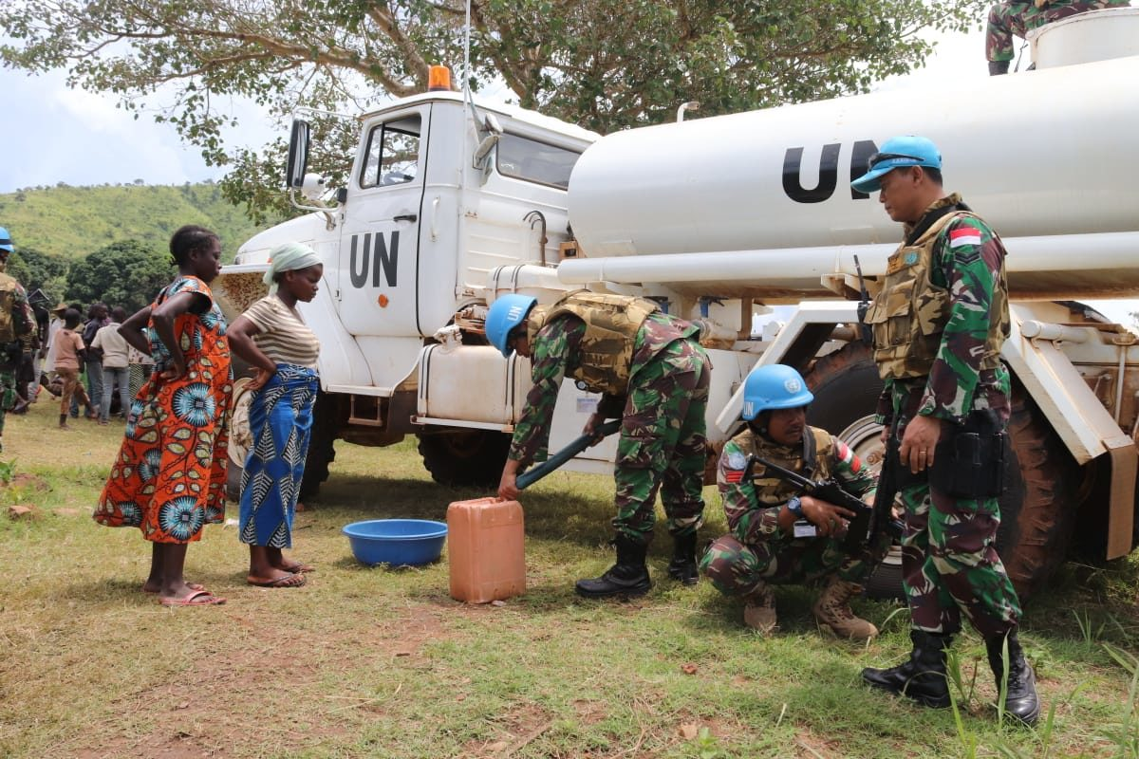
Amahame y’ingenzi yo kubungabunga amazi
7

Slide 8
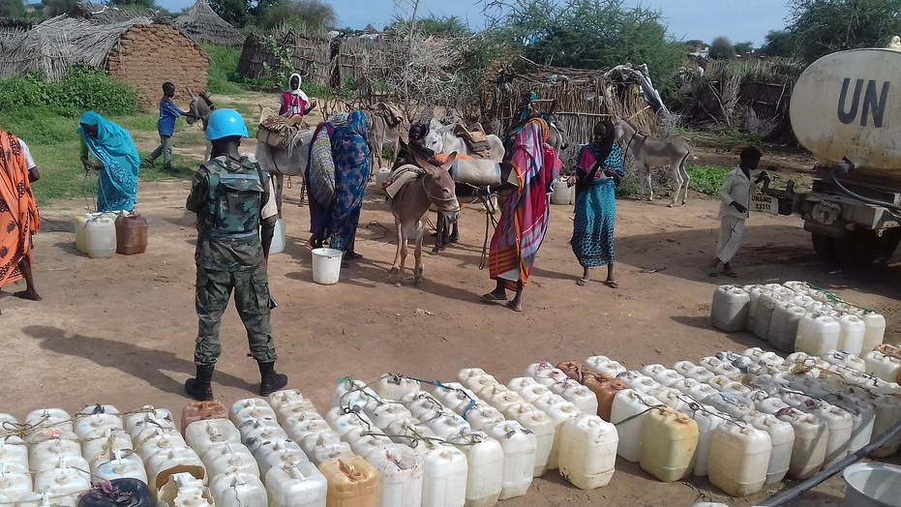
Amahame y’ingenzi yo kubungabunga amazi
Amazi ashobora kuba adahagije ahakorerwa ubutumwa bwo kugarura Amahoro. Kubika no gukoresha neza amazi muburyo bwose bushoboka byatuma hirindwa igabanuka ry’amazi meza ku baturage kuburyo byakwitirirwa ubutumwa bw’amahoro.
8

Slide 9
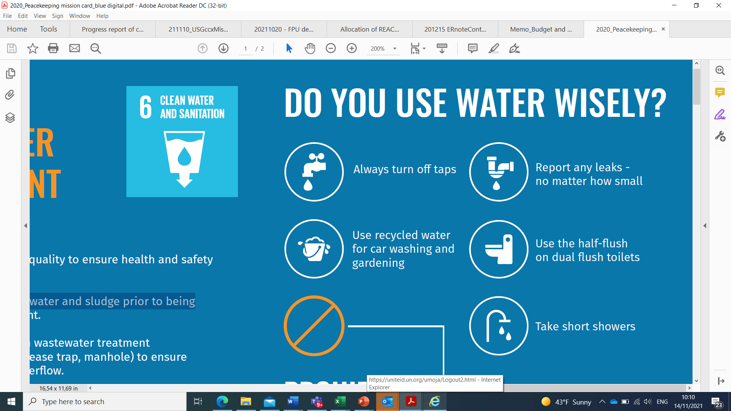
Amahame y’ingenzi yo kubungabunga amazi
IBIKWIYE GUKORWA | IBIDAKWIYE GUKORWA
√ Gukoresha amazi make wiyuhagira. | χ Ntugasige robine zifunguye
√ Kwibuka gufunga robine buri gihe uko urangije gukoresha amazi. | χ Ntukareke amazi atonyanga
√ Gufunga robine igihe woza ibikoresho byo mugikoni, cyangwa igihe woza amenyo. | χ Kwirinda kuyobora ibikomoka kuri petelori mu migezi, ibidendezi by’amazi, ibyobo byagenewe kujyamo imyanda ivuye mu misarani, cyangwa imiferege, mu rwego rwo kwirinda iyororoka ry’imibu n’imyuka ihumanya
√ Tegereza amazi yuzure imashini imesa hanyuma ujye ukoresha akenewe.
√ Ku ubwiherero bufite imiyobora ibiri koresha utwara amazi make aho bishoboka.
√ Koresha amazi y’imvura, nayandi azanwa n’ibyuma bikonjesha mukuhira ibiti.
√ Menyekanisha kugihe aho ariho hose amazi atonyanga utitaye kungano yayo.
9

Slide 10
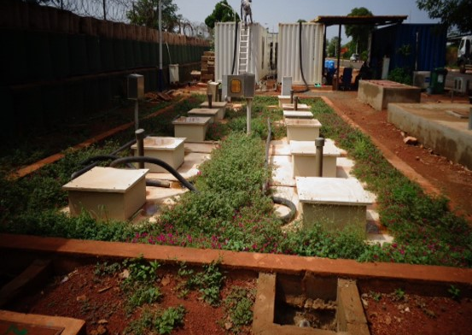
Amahame y’ingenzi mu kubungabunga amazi arimo imyanda
10

Slide 11
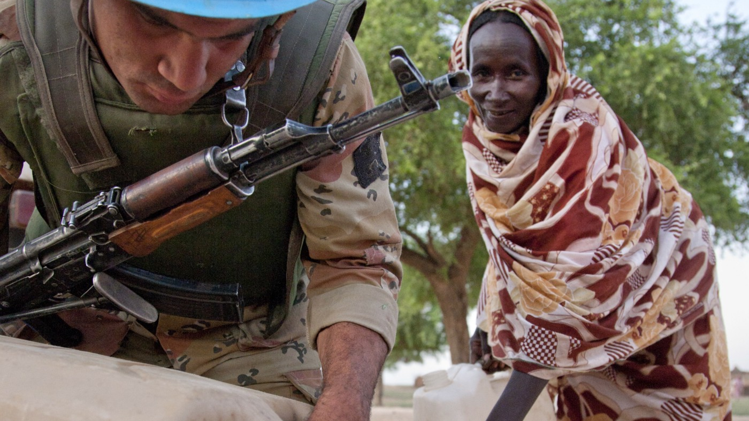
Amahame y’ingenzi mu kubungabunga amazi arimo imyanda
Ugomba kumenya ko 80% y’amazi akoreshwa buri munsi ahinduka amazi arimo imyanda kandi akeneye gucungwa no gutunganywa neza n’abari mu butumwa.
Ku bireba Umuntu kugiti cye, abakozi bari mubutumwa bw’amahoro bwa Loni banduza amazi binyuze, mugukoresha imisarani, kwiyuhagira no gukorera isuku aho batuye, guteka, kumesa no kwoza ama modoka by’umwihariko.
Ni itegeko gucunga neza ahagenewe gutunganyirizwa amazi yakoreshejywe mu rwego rwo kwirinda ingaruka yagira ku bidukikije.
11

Slide 12
Amahame y’ingenzi mu kubungabunga amazi arimo imyanda
IBIKWIYE GUKORWA | IBIDAKWIYE GUKORWA
√ Gukoresha amazi yasukuwe cyangwa ay’imvura mubikorwa byo kuhira ubusitani, kwoza amamodoka, gusukura, kugabanya imikungugu no kuyakoresha mu misarane aho bishoboka. | χ Kwirinda kumena imyanda irimo ibinyabutabire, amasashi, ibiryo byasagutse, n’indi myanda yo murugo mu misarani, hirindwa ko imiyoboro y’amazi yaziba.
√ Kwita ku isuku no gucunga neza ibikorwa remezo by’isuku nko gusukura imisarani, no kugenzura ibyobo bifata amazi, ndetse no gusukura imiyoboro yabyo , n’ibindi,... | χ Kwirinda kunywa amazi yarimo imyanda hanyuma agatunganywa, no kutayakoresha mugikoni no kwiyuhagira.
√ Gutangira amakuru ku gihe mu gihe habayeho kwandura kw’amazi akoreshwa n’abakozi bari mubutumwa. | χ Kwirinda kumena amavuta cyangwa ibikomoka kuri petelori mu mazi, ibyobo bibika imyanda n’imiyoboro y’amazi mu rwego rwo gukumira imibu n’imyuka mibi.
12

Slide 13

Amahame agenga kubika ingufu z’amashanyarazi
13

Slide 14
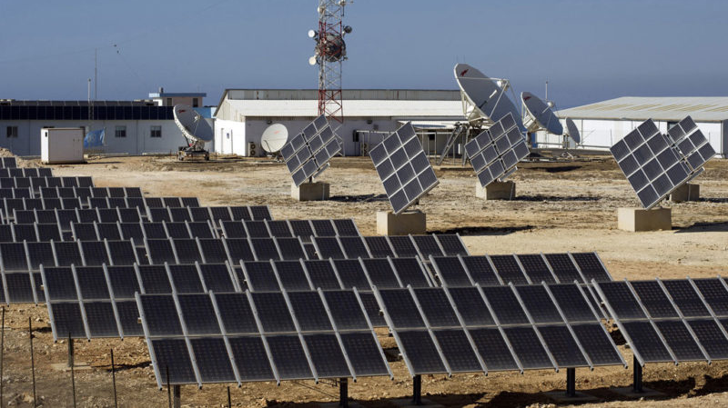
Amahame agenga kubika ingufu z’amashanyarazi
Akenshi mu butumwa bwo kugarura amahoro, ingufu z’amashanyarazi zitangwa n’imashini zikoreshwa n’ibikomoka kuri petelori. Imyuka ijya mu kirere yoherezwa nizo mashini mu gihe zitanga amashanyarazi.
Mu rwego rwo kugabanya ingaruka ku bidukikije, ingufu z’amashanyarazi yisubira zikwiye gusimbura imashini zikoreshwa n’ibikomoka kuri petelori.
14

Slide 15
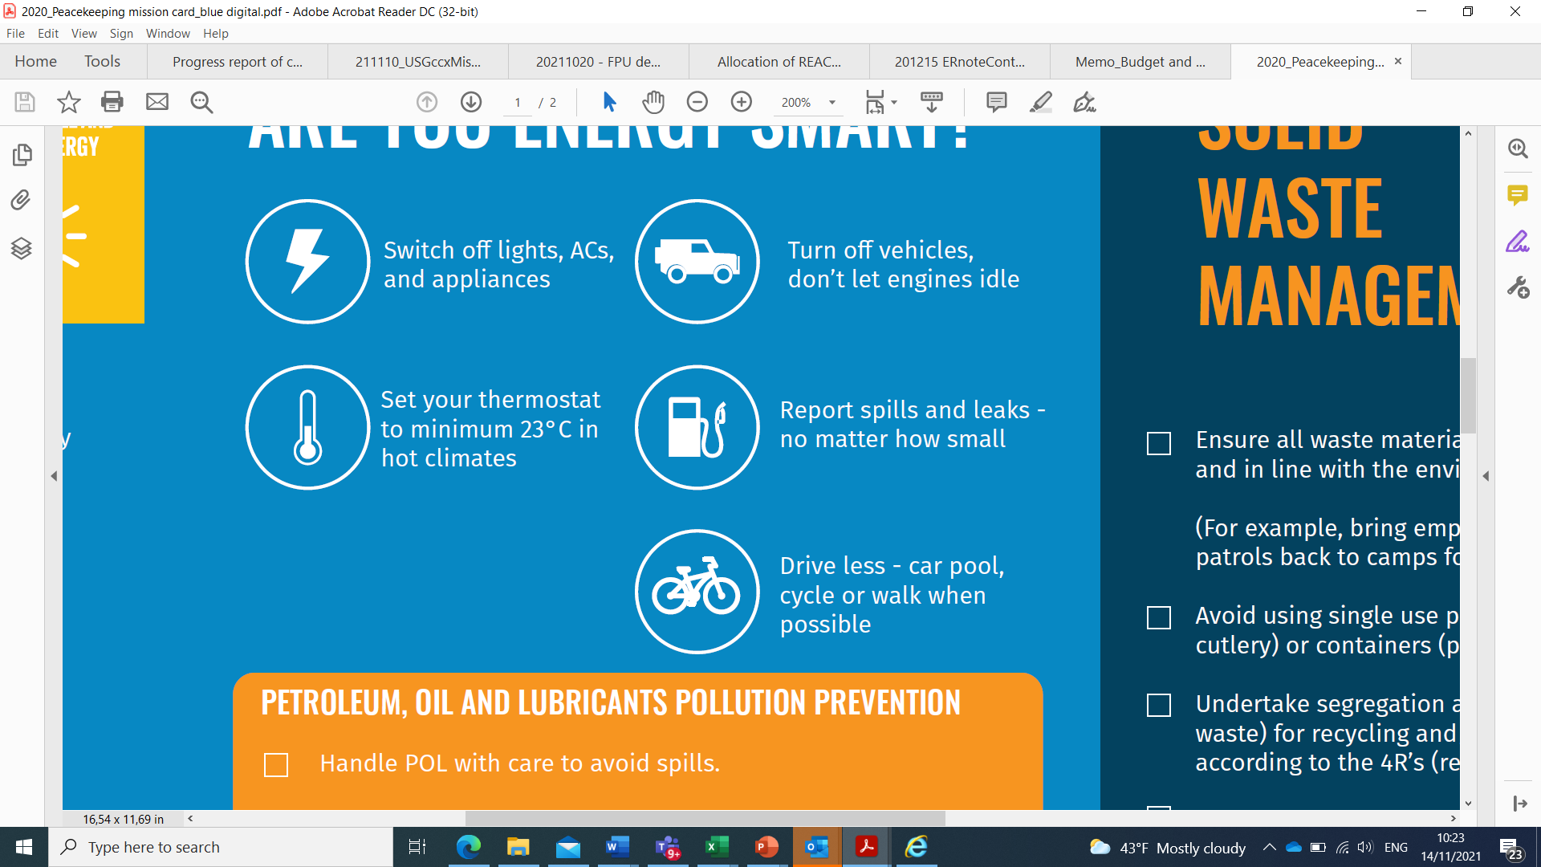
Amahame agenga kubika ingufu z’amashanyarazi
IBIKWIYE GUKORWA | IBIDAKWIYE GUKORWA
√ Kwibuka gukinga amadirishya n’imiryango mu gihe ibyuma bitanga ubukonje birimo bikora | χ Kwirinda gusiga imodoka yaka, ibuka kuzimya imodoka mu gihe utayirimo
√ Mu gihe uri aho utuye cyangwa aho ukorera, ugomba gushyira icyuma gitanga ubukonje kukigero cya dogere 23 cyangwa kuzamura (mubihe by’ubushyuhe) | χ Kwirinda gusiga amatara n’ ibyuma bitanga ubukonje byaka mu gihe nta muntu uri munzu.
√ Ibuka kuzimya amatara n’ibyuma bitanga ubukonje mugihe usohotse mu nzu | χ Kubw’umutekano wawe n’uwa bagenzi bawe irinde kwishyiriraho umuyoboro w’amashanyarazi udateganyijwe cyangwa ukinishe ibikoresho byayo.
√ Mu gihe urangije kumesa anika imyenda yawe wirinde kuyumisha ukoresheje imashini
√ Mu gihe ugiye mu kiruhuko hanze y’ubutumwa ibuka gusiga uzimije ibyuma bitanga ubukonje n’ibitanga ingufu z’amashanyarazi usibye firigo
√ Kugendesha amaguru cyangwa igare ujya mu kazi.
√ Gukoresha cyane imodoka rusange
√ Kumeshesha amazi akonje aho bishoka, aho gukoresha ashyushye
15

Slide 16
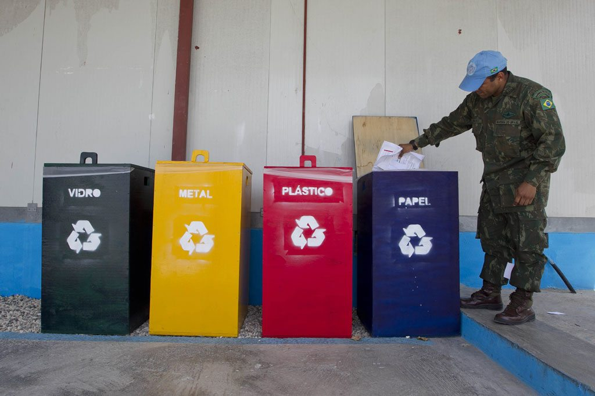
Amahame agenga imicungire y’imyanda itabora
16

Slide 17
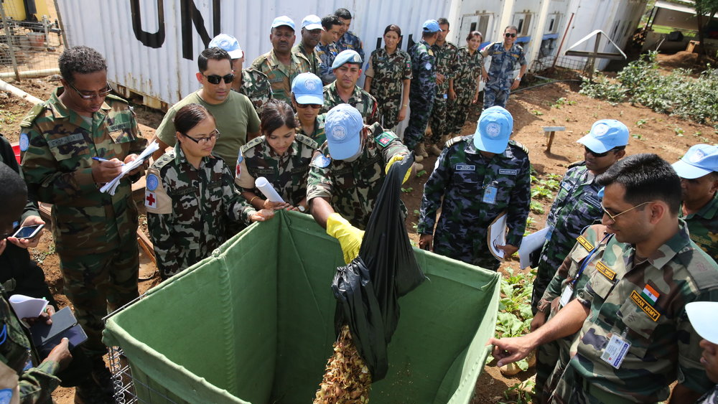
Amahame agenga imicungire y’imyanda itabora
Mu mateka y’ubutumwa bw’amahoro imyanda itabora imenwa mubimoteri bya leta biri hanze y’ibigo bya loni.
Imyanda itabora ishobora kugira ingaruka kubidukikije no kubuzima bw’abaturage mu gihe idacunzwe neza.
17

Slide 18
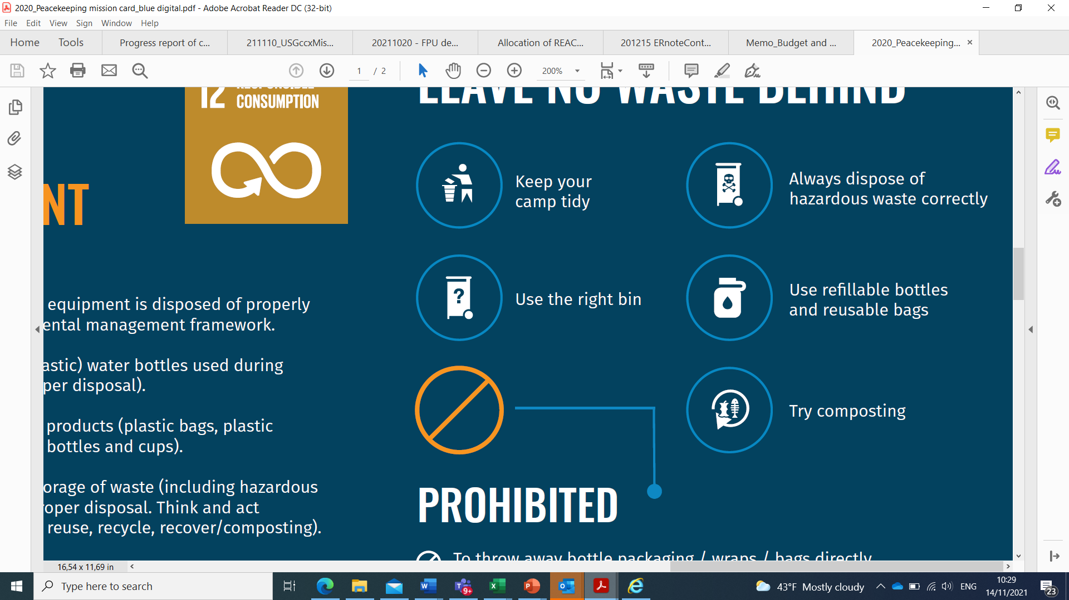
Amahame agenga imicungire y’imyanda itabora
IBIKWIYE GUKORWA | IBIDAKWIYE GUKORWA
√ Kumena imyanda ahabugenewe gusa | χ Kwirinda kumena imyanda ahatabugenewe
√ Kuvangura ibikoresho byasubirwamo (aluminiyumu, ibikombe bivamo ibiryo, amasashi, impapuro, ibikarito, n’amacupa avamo amazi ) n’imyanda isanzwe | χ Kwirinda gutwikira imyanda ahatabugenewe
√ Gutandukanya ibishishwa by’imboga, iby’amagi, ibisigazwa by’ikawa n’icyayi, mu rwego rwo kubibyaza ifumbire | χ Kwirinda gutaba imyanda ahatabugenewe
√ Igihe ugiye mu kazi hanze y’ikigo ibuka kugarura ibisigazwa by’ibyakoreshejwe kugirango bishyirwe ahabugenewe mu kigo | χ Kwirinda kujugunya amacupa, ibyo kurya byasigaye, ibikarito by’imitobe ahantu hatabugenewe
√ Gukoresha ibikapu bidakoreshwa inshuro imwe | χ Aho bishoboka hakwirindwa kugura amacupa y’amazi akoze muri pulasitike ari munsi ya litiro imwe
√ Koresha amacupa y’amazi akoreshwa kenshi
√ Gutegura ibiryo mushobora kumara mu rwego kwirinda imyanda ibikomokaho
√ Gukoresha ibyo kurya mbere y’igihe byagenewe
18

Slide 19
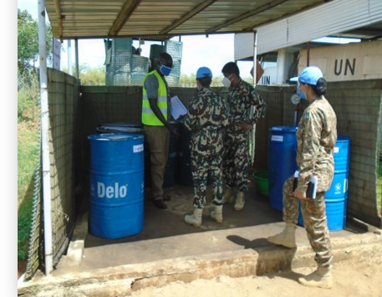
Amahame y’ingenzi yo gukumira ingaruka zaturuka ku myanda
19

Slide 20
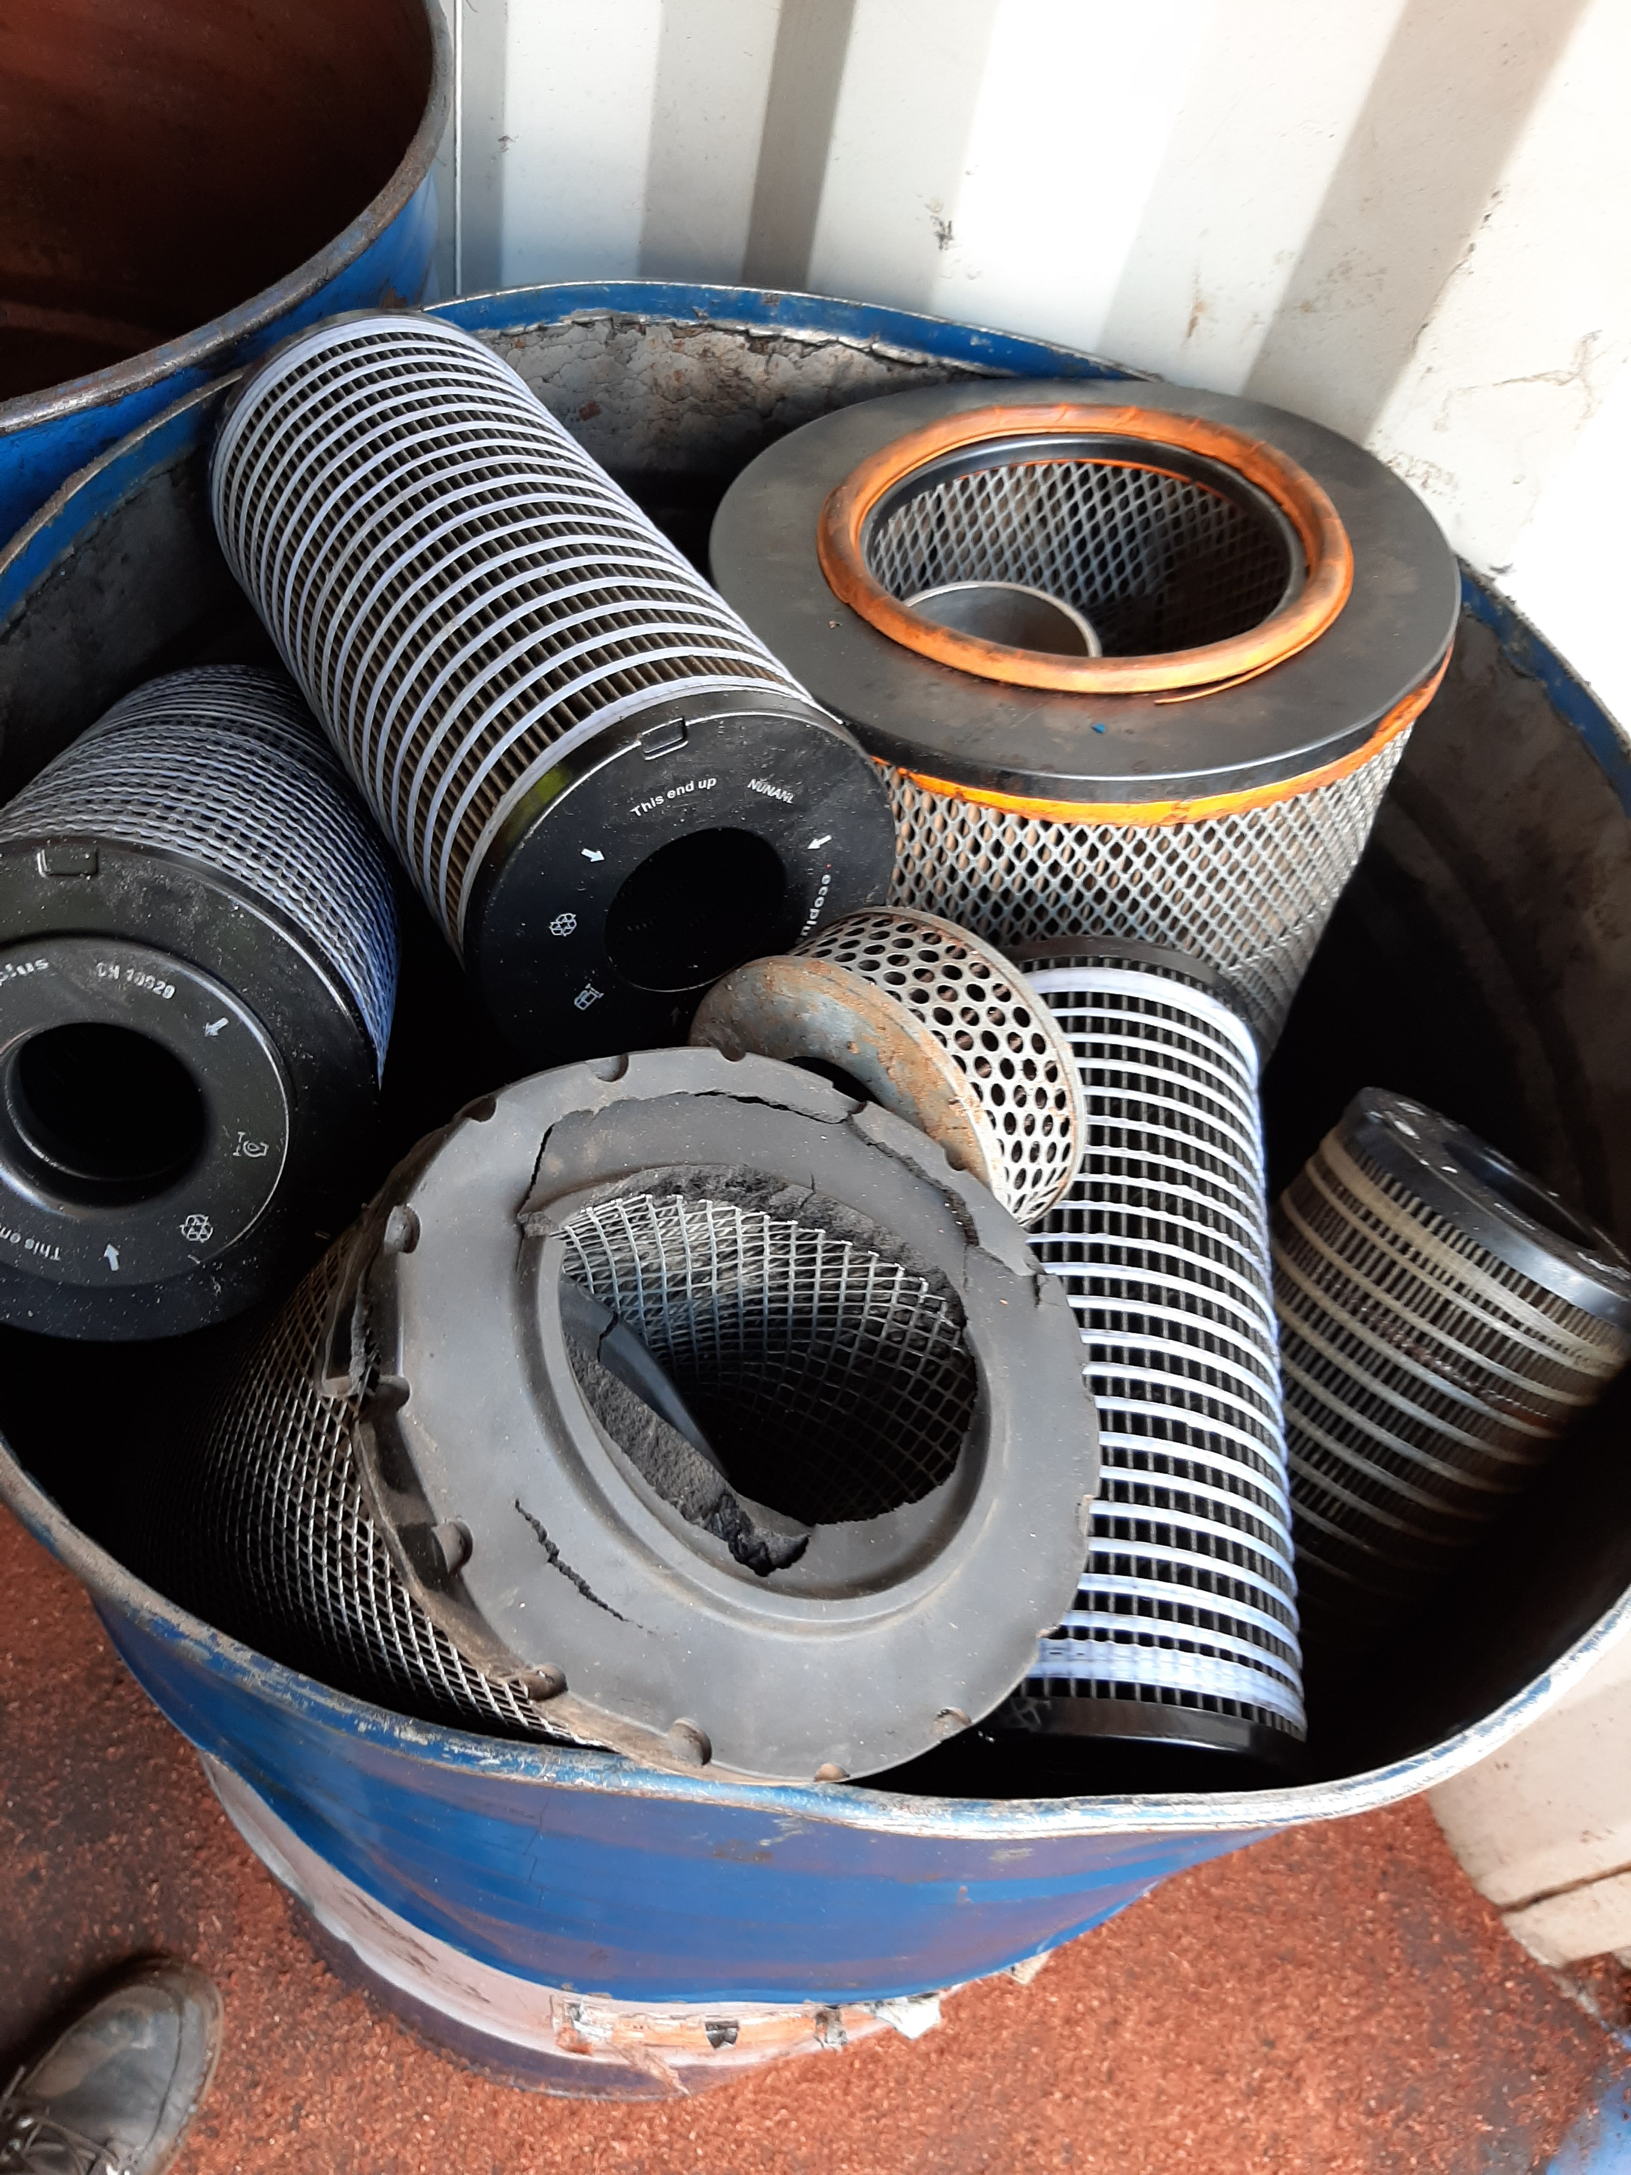
Amahame y’ingenzi yo gukumira ingaruka zaturuka ku myanda
Bimwe mu bikoresho bikoreshwa mubutumwa bwo kugarura amahoro, bigira ingaruka igihe byarengeje igihe cyangwa byakoreshejwe.
Gucunga neza imyanda yateza ingaruka hagamijwe kurinda ubuzima bw’abakozi, abenegihugu ndetse n’ibidukikije.
20

Slide 21
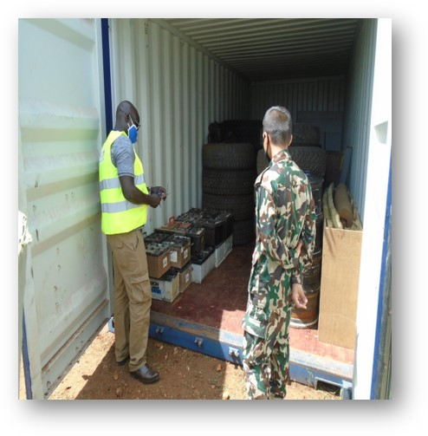
Imyanda yateza ingaruka ikomoka kubikorwa by’abari mubutumwa, imwe ni iyi ikurikira:
  Aside yo muri batiri
  Amavuta cyangwa ibikomoka kuri petelori byakoreshejwe
  Amavuta yo muri firitiri
  Imyanda ikomoka kwa muganga
  Imiti yarengeje igihe
  Ibikomoka kubinyabutabire n’imyanda yateza ingaruka
  Imiti yica udukoko
  Ibikoresho bya elegitironiki/ikorana buhanga
  Ibinyabutabire biva muri za laboratwari
  Ampulu/Tibe z’amashanyarazi
  Ubutaka bwanduye biturutse kumavuta yamenetse, ibitori by’amasasu, ahakorerwa imyitozo yo kumasha.
21

Slide 22
IBIKWIYE GUKORWA | IBIDAKWIYE GUKORWA
√ Guhuriza hamwe no kubika amavuta ayo ariyo yose ndetse n’imyanda yateza ingaruka. | χ Kwirinda kuvanga imyanda yateza ingaruka n’indi myanda ituruka mu ngo.
√ Guhuriza hamwe amavuta yakoreshejwe mugihe bahindura amavuta yo mumodoka hirindwa ko yamenwa ahatabugenewe. | χ Kwirinda gutaba cyangwa gutwikira imyanda yateza ingaruka ahatabugenewe.
√ Guhuriza hamwe ibikoresho byakuwemo amavuta ndetse na za firitiri z’amavuta ahabugenewe kugirango bizavanwemo ibindi bikoresho. | χ Kwirinda gushyira imiti yarengeje igihe mu bimoteri rusange, ahubwo bihabwa abaganga babishinzwe kugiranga bishyirwe ahabugenewe.
√ Kuzana imyanda yose ikomoka kwa muganga ndetse n’imiti yarengeje igihe, kubaganga babishinzwe kugirango ishyirwe ahabugenewe hatabangamira ubuzima bw’abantu n’ibidukikije | χ Kwirinda itonyanga ry’amavuta y’ ibikomoka kuri petelori cyangwa ibinyabutabire.
√ Kuzana indi myanda yose yeteza ingaruka ahantu habugenewe mu kigo kugirango icungwe muburyo itateza ibibazo. | χ Kwirinda kubika imyanda yateza ingaruka hafi y’igikoni, ububiko bw’ibyo kurya, ibigega by’amazi, imiyoboro y’amazi, iruhande rw’umuriro n’ ahegereye aho amashanyarazi yakirizwa.
√ Ibuka Gukoresha ibikoresho byo kwirinda byagugenewe mu gihe utunganya imyanda yateza ingaruka. | χ Kwirinda kuvanga imyanda yateza ingaruka n’indi myanda ituruka mu ngo.
√ Kwita k’umutekano w’ibikoresho byagenewe kubika no gutwara imyanda yateza ingaruka, hakurikizwa ingero z’ababikora neza.
√ Gutangira kugihe amakuru yerekranye n’imeneka ryibikomoka kuri petelori, binyabutabire mu rwego rwo gukumira no kwirinda ihumanywa ry’ubutaka n’amazi.
Amahame y’ingenzi yo gukumira ingaruka zaturuka ku myanda
22

Slide 23
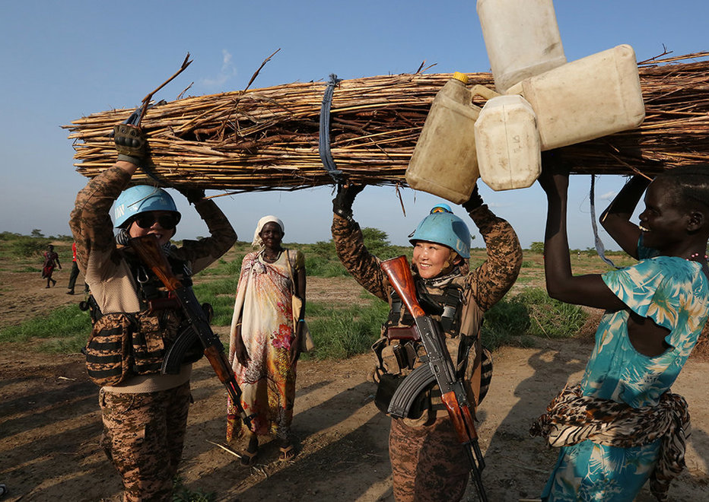
Amahame y’ingenzi mu kurinda imitungo kamere n’ umurage w’umuco
23

Slide 24
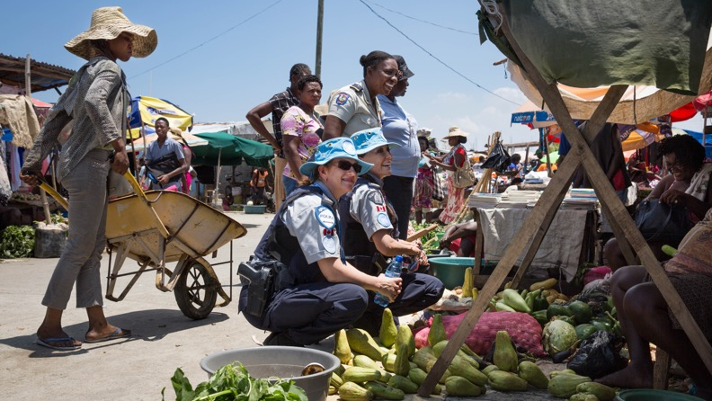
Amahame y’ingenzi mu kurinda imitungo kamere n’ umurage w’umuco
Imitungo kamere ishobora kuba ingirakamaro kubuzima bw’abaturage kubijyanye no kubona ibyo kurya, gucana, imibereho myiza n’ibindi bikorwa ngengabukungu.
Imitungo kamere nk’urusobe rw’ibinyabuzima, ni ingirakamaro kandi ku mibereho y’inyamaswa, ibimera n’ibinyabuzima bigenda bishira no kurinda urusobe rw’ibinyabuzima.
24

Slide 25
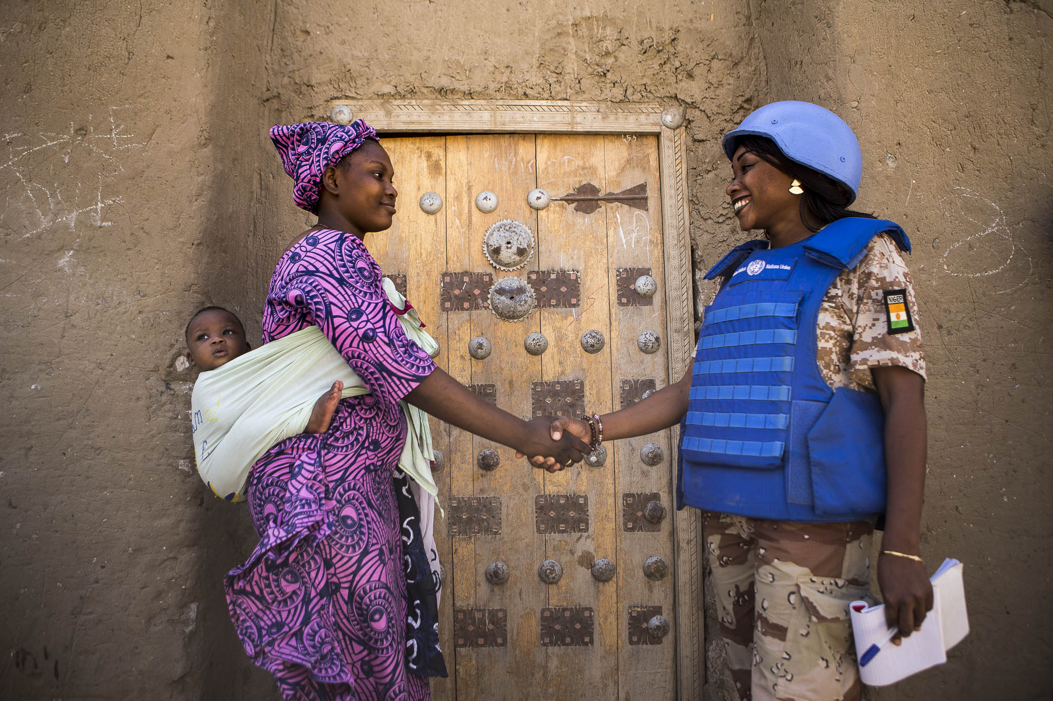
Ibyanya by’ Imirage ndangamuco, nk’ ishingiye ku iyobokamana, imirage ndangamateka biba ari iby’agaciro ku benegihugu. Igihe habayeho kubyangiza bigira ingaruka ku mibanire hagati y’abari mu ubutumwa bwa Loni n’abenegihugu na Leta zabo.
25

Slide 26

Amahame y’ingenzi mu kurinda imitungo kamere n’
umurage w’umuco
IBIKWIYE GUKORWA | IBIDAKWIYE GUKORWA
√ Kugira uruhare mu gutera ibiti no mu zindi ngamba zigamije isukurwa ry’ibidukikije. | χ Kwirinda kugura amakara cyangwa inkwi kuko bigira uruhare mu kurimbura amashyamba.
√ Kwirinda ingaruka z’imiriro yo mu mpeshyi hacungwa neza imyanda. | χ Kwirinda Gukoresha amakara cyangwa inkwi mu guteka
√ Kumenya imirage ndangamuco, imyemerere, imirage ndangamateka no kugira imyitwarire ibihesha agaciro. | χ Do not encourage poaching of wildlife by buying Kwirinda gutunga, korora cyangwa gucirira inyamaswa z’aho ubutumwa bukorerwa.
√ Gushyiraho uburyo buboneye bwo gusohora impapuro muri mudasobwa (gu printinga), urugero; hajya hasohorwa urupapuro rwanditseho impande zombi no Gukoresha impapuro zatunganyijwe bundi bushya. | χ Kurwanya ubuhigi butemewe n’amategeko hirindwa kugura imitako ikomoka kunyamaswa, ndetse no kugura inyama zikomoka kunyamaswa z’ishyamba.
√ Ugomba gusaba uruhushya kubabifitiye ububasha mbere yo gutema ibiti bikuze. | χ Kwirinda gukurura imbwa n’injangwe z’agasozi mu kigo uzigaburira cyangwa ujugunya ibiryo byasigaye ahatarabugenewe.
 | χ Kwirinda guhiga, gucirira, gusarura, kugura ,guhabwa inyamaswa cyangwa ibimera byo mu gasozi, bipfuye cyangwa ari bizima, cyangwa ibindi byose bibikomokaho.
 | χ Kwirinda kuzana ibimera cyangwa imbuto ubivanye mugihugu cyawe bitari ibyo mu gihugu mukoreramo ubutumwa.
 | χ Kwirinda gutera amoko y’ibimera bitamenyerewe mu gihugu kiberamo ubutumwa.
26

Slide 27
Location Based Slide
Add more specific guidance about the local environment
27

Slide 28
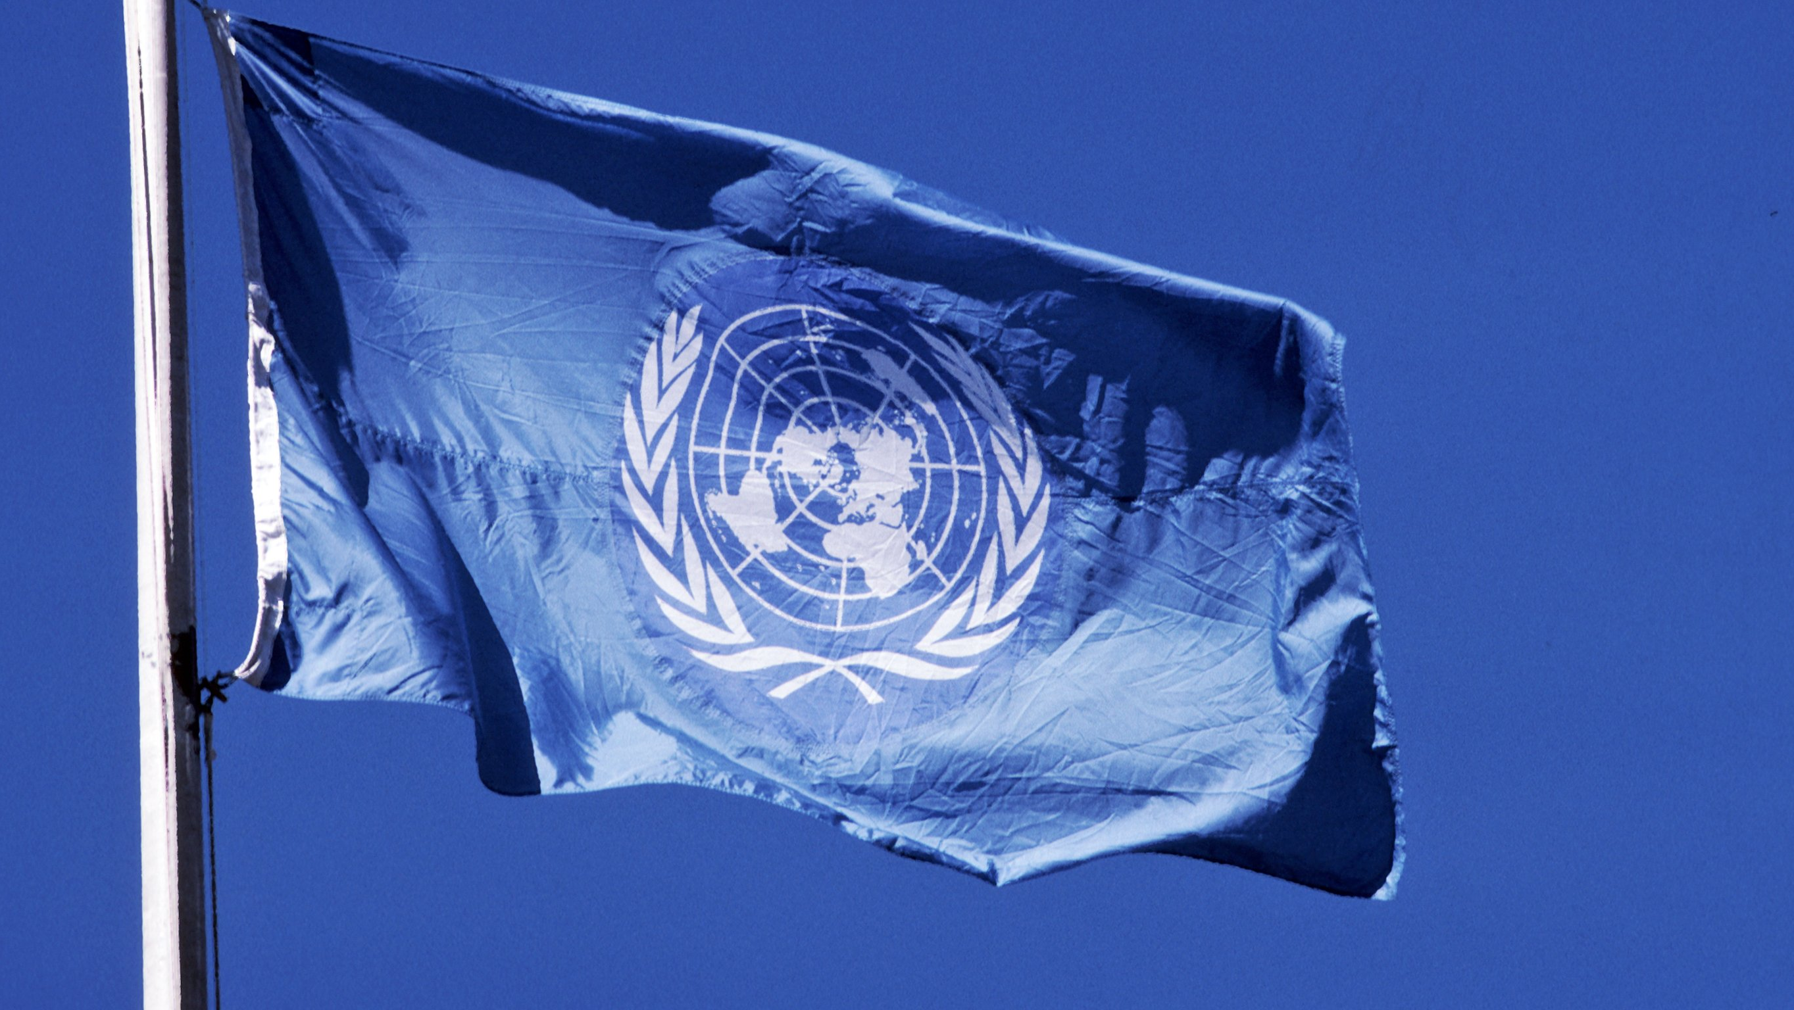


Brought to you by the Department of Operational Support and the Department of Peace Operations
28

Slide 29
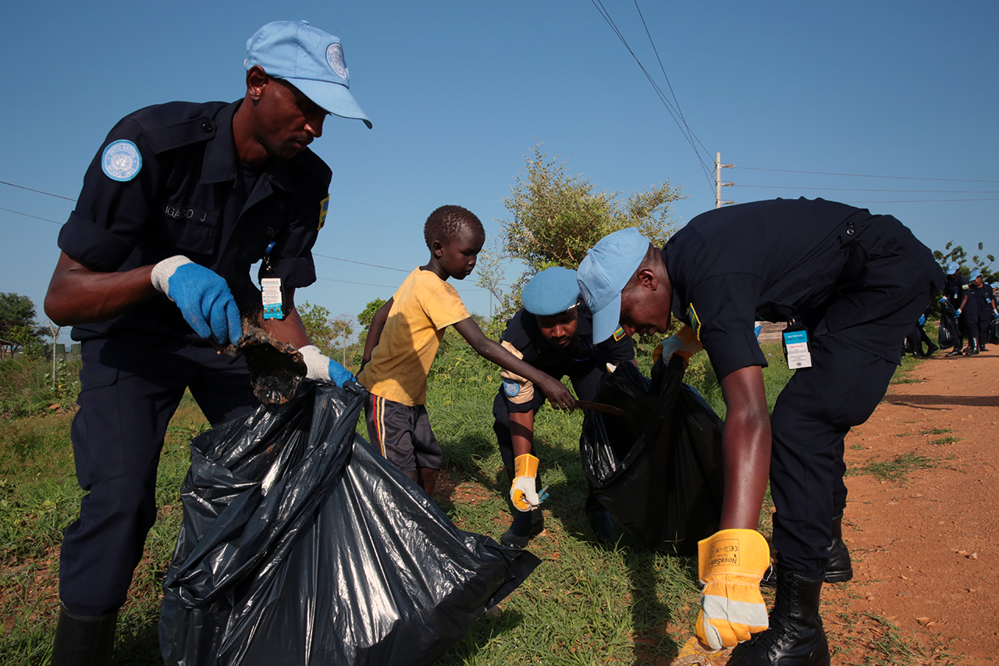
Murakoze
29

